Slide 1

Semi-Supervised classification with Graph Convolutional Networks
Team SMAIL:
Aman Atman(2020121006)
Kirthi Vignan(2020122004)
Rishav Goenka (2019112007)
Yash Motwani(2020122002)
This Photo by Unknown author is licensed under CC BY-NC.

Slide 2
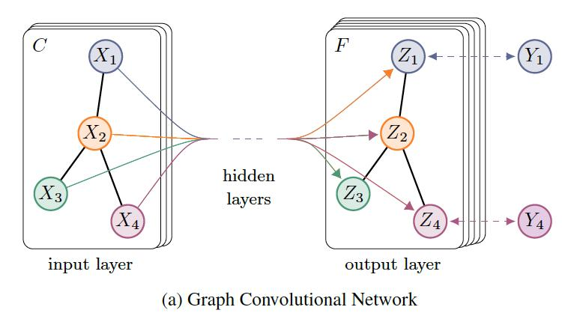
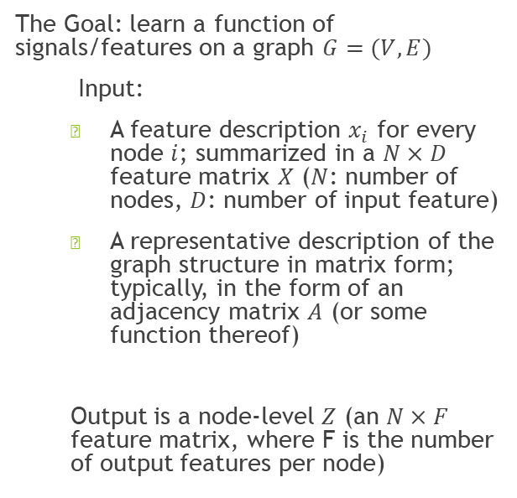
Graph Convolutional Network
The Goal: learn a function of signals/features on a graph $G=(V,E)$
Input:
A feature description $x_{i}$ for every node $i$; summarized in a $N×D$ feature matrix $X$ ($N$: number of nodes, $D$: number of input feature)
A representative description of the graph structure in matrix form; typically, in the form of an adjacency matrix $A$ (or some function thereof)
Output is a node-level $Z$ (an $N×F$ feature matrix, where F is the number of output features per node)

Slide 3
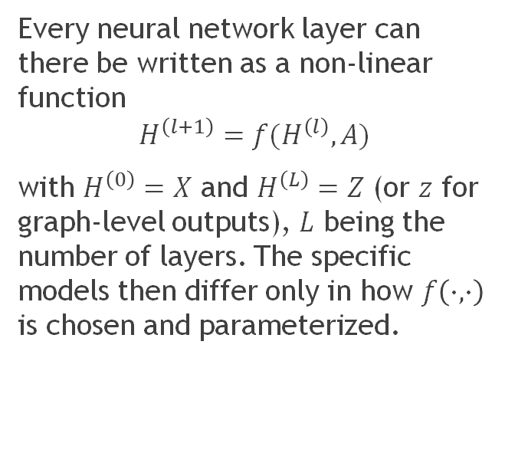
Graph Convolutional Network
Every neural network layer can there be written as a non-linear function
$$H^{\left(l+1\right)}=f(H^{\left(l\right)},A)$$
with $H^{\left(0\right)}=X$ and $H^{\left(L\right)}=Z$ (or $z$ for graph-level outputs), $L$ being the number of layers. The specific models then differ only in how $f\left(∙,∙\right)$ is chosen and parameterized.
Cora t-SNE visualization

Slide 4
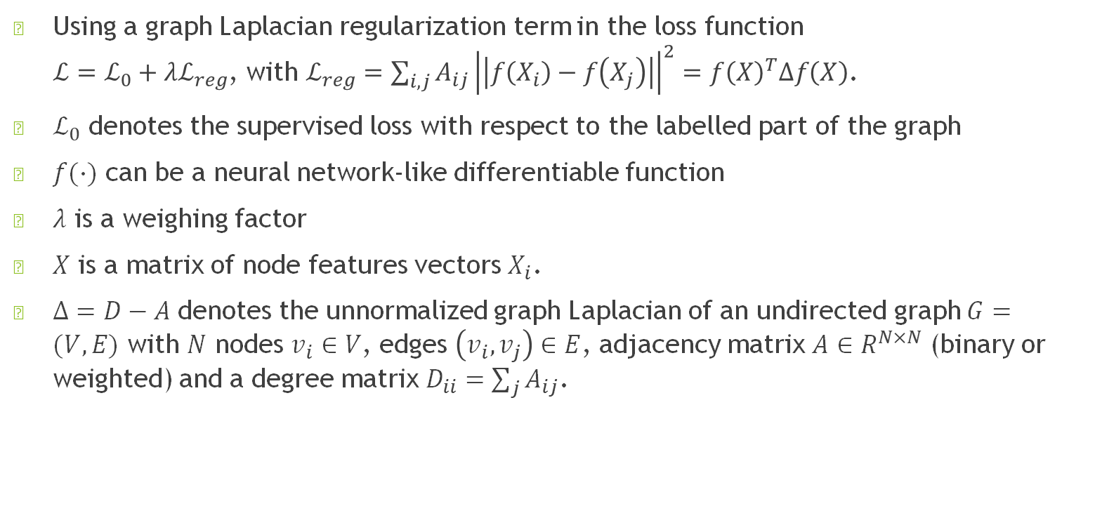
Loss Function
Using a graph Laplacian regularization term in the loss function $ℒ=ℒ_{0}+λℒ_{reg}$, with $ℒ_{reg}=\sum_{i,j}{A_{ij}{\left|\left|f\left(X_{i}\right)−f\left(X_{j}\right)\right|\right|}^{2}=f{\left(X\right)}^{T}Δf\left(X\right)}$.
$ℒ_{0}$ denotes the supervised loss with respect to the labelled part of the graph
$f(∙)$ can be a neural network-like differentiable function
$λ$ is a weighing factor
$X$ is a matrix of node features vectors $X_{i}$.
$Δ=D−A$ denotes the unnormalized graph Laplacian of an undirected graph $G=(V,E)$ with $N$ nodes $v_{i}∈V$, edges $\left(v_{i}, v_{j}\right)∈E$, adjacency matrix $A∈R^{N×N}$ (binary or weighted) and a degree matrix $D_{ii}=\sum_{j}{A_{ij}}$.

Slide 5
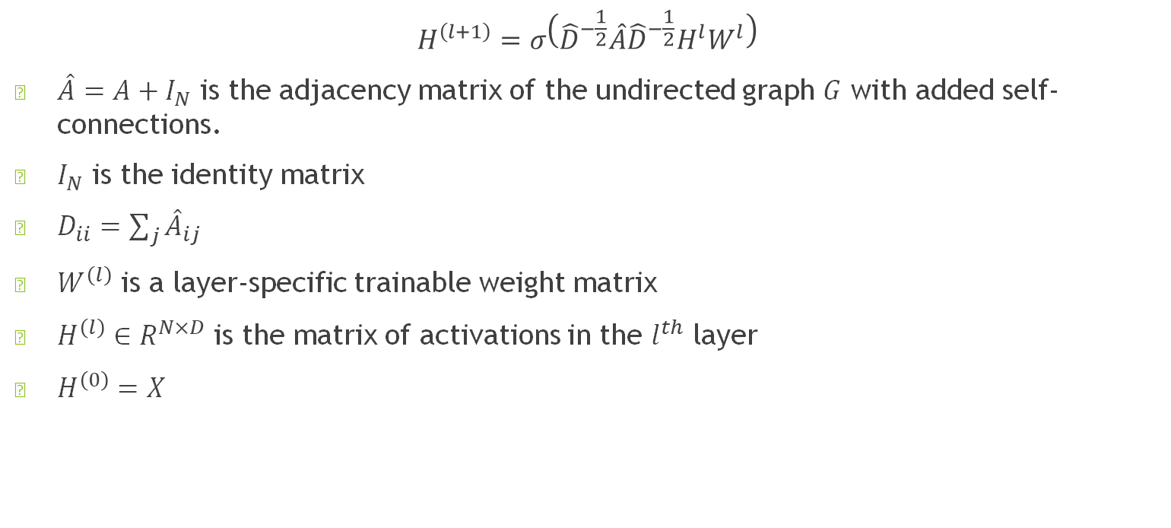
Fast Approximate Convolutions on Graphs
$$H^{\left(l+1\right)}=σ\left({\hat{D}}^{−\frac{1}{2}}\hat{A}{\hat{D}}^{−\frac{1}{2}}H^{l}W^{l}\right)$$
$\hat{A}=A+I_{N}$ is the adjacency matrix of the undirected graph $G$ with added self-connections.
$I_{N}$ is the identity matrix
$D_{ii}=\sum_{j}{{\hat{A}}_{ij}}$
$W^{\left(l\right)}$ is a layer-specific trainable weight matrix
$H^{\left(l\right)}∈R^{N×D}$ is the matrix of activations in the $l^{th}$ layer
$H^{\left(0\right)}=X$

Slide 6
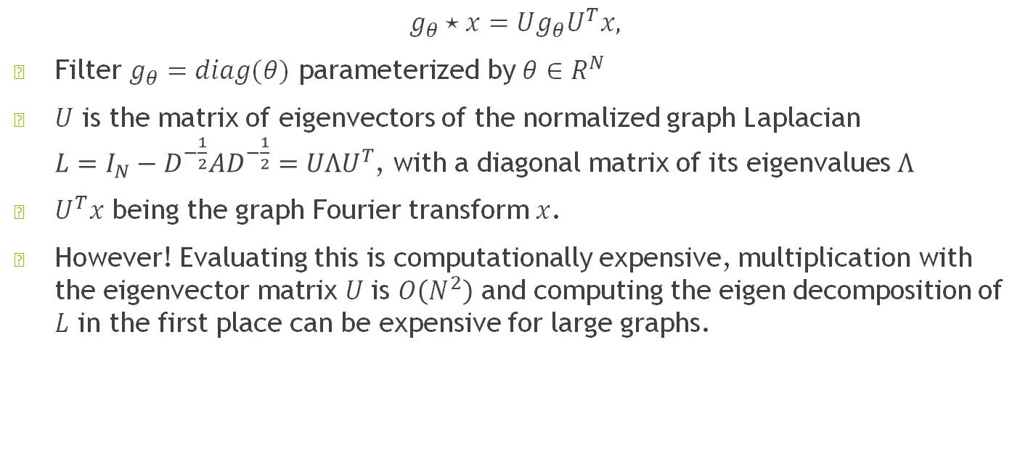
Spectral Graph Convolutions
$$g_{θ}⋆x=Ug_{θ}U^{T}x,$$
Filter $g_{θ}=diag(θ)$ parameterized by $θ∈R^{N}$
$U$ is the matrix of eigenvectors of the normalized graph Laplacian $L=I_{N}−D^{−\frac{1}{2}}AD^{−\frac{1}{2}}=UΛU^{T}$, with a diagonal matrix of its eigenvalues $Λ$
$U^{T}x$ being the graph Fourier transform $x$.
However! Evaluating this is computationally expensive, multiplication with the eigenvector matrix $U$ is $O\left(N^{2}\right)$ and computing the eigen decomposition of $L$ in the first place can be expensive for large graphs.

Slide 7
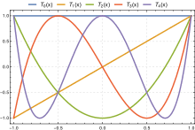
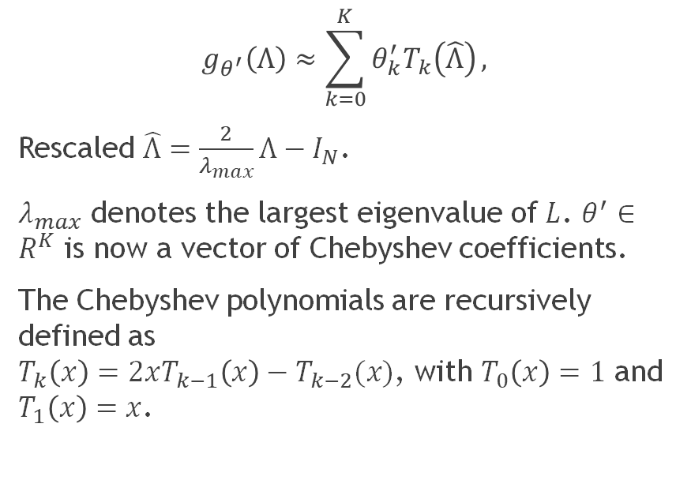
Chebyshev Polynomial Approximation
$$g_{θ^{′}}\left(Λ\right)≈\sum_{k=0}^{K}{θ_{k}^{′}T_{k}\left(\hat{Λ}\right)},$$
Rescaled $\hat{Λ}=\frac{2}{λ_{max}}Λ−I_{N}$.
$λ_{max}$ denotes the largest eigenvalue of $L$. $θ^{′}∈R^{K}$ is now a vector of Chebyshev coefficients.
The Chebyshev polynomials are recursively defined as $T_{k}\left(x\right)=2xT_{k−1}\left(x\right)−T_{k−2}(x)$, with $T_{0}\left(x\right)=1$ and $T_{1}\left(x\right)=x$.

Slide 8
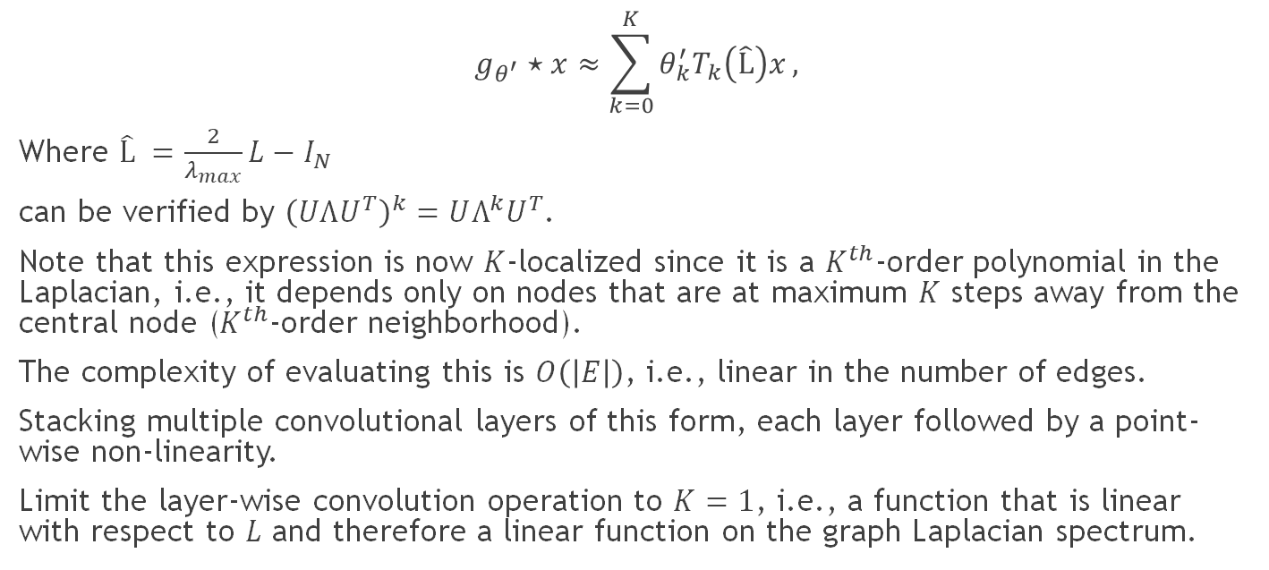
Chebyshev Polynomial Approximation
$$g_{θ^{′}}⋆x≈\sum_{k=0}^{K}{θ_{k}^{′}T_{k}\left(\hat{L}\right)x},$$
Where $\hat{L} =\frac{2}{λ_{max}}L−I_{N}$
can be verified by ${\left(UΛU^{T}\right)}^{k}=UΛ^{k}U^{T}$.
Note that this expression is now $K$-localized since it is a $K^{th}$-order polynomial in the Laplacian, i.e., it depends only on nodes that are at maximum $K$ steps away from the central node ($K^{th}$-order neighborhood).
The complexity of evaluating this is $O\left(\left|E\right|\right)$, i.e., linear in the number of edges.
Stacking multiple convolutional layers of this form, each layer followed by a point-wise non-linearity.
Limit the layer-wise convolution operation to $K=1$, i.e., a function that is linear with respect to $L$ and therefore a linear function on the graph Laplacian spectrum.

Slide 9
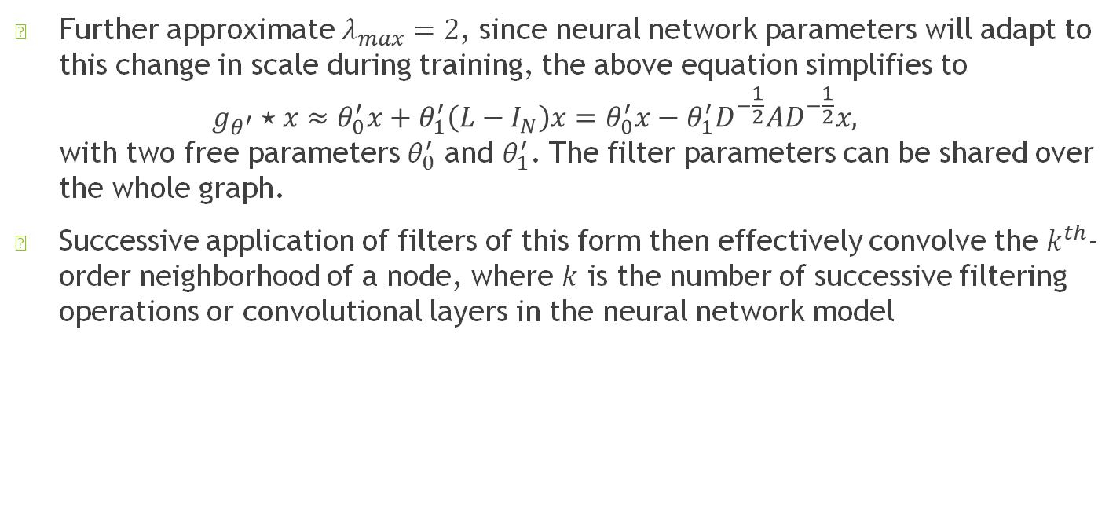
Further Approx.
Further approximate $λ_{max}=2$, since neural network parameters will adapt to this change in scale during training, the above equation simplifies to $g_{θ^{′}}⋆x≈θ_{0}^{′}x+θ_{1}^{′}\left(L−I_{N}\right)x=θ_{0}^{′}x−θ_{1}^{′}D^{−\frac{1}{2}}AD^{−\frac{1}{2}}x,$ with two free parameters $θ_{0}^{′}$ and $θ_{1}^{′}$. The filter parameters can be shared over the whole graph.
Successive application of filters of this form then effectively convolve the $k^{th}$-order neighborhood of a node, where $k$ is the number of successive filtering operations or convolutional layers in the neural network model

Slide 10
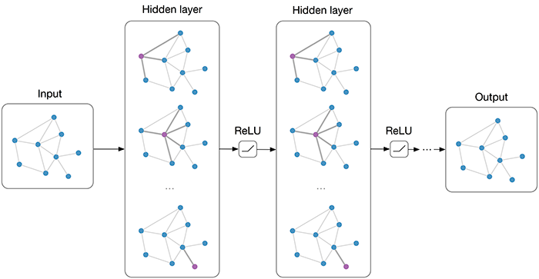
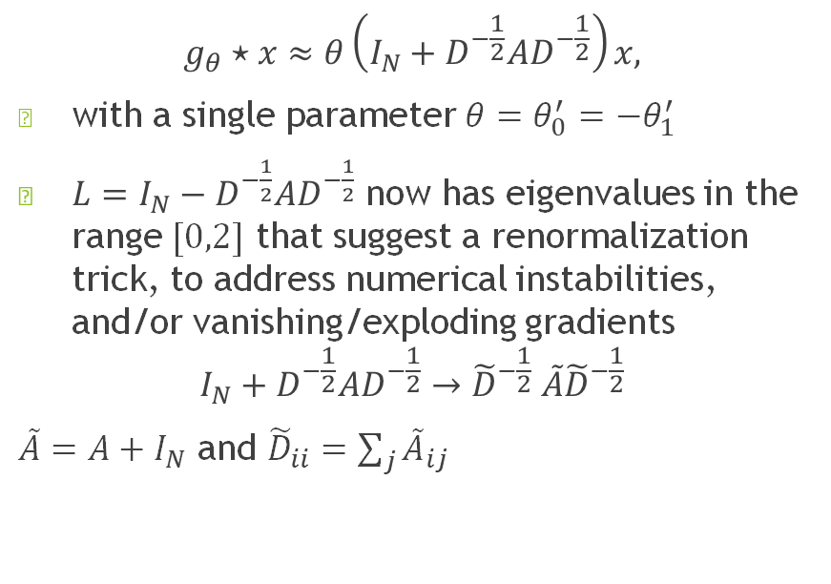
Further Approx.
$$g_{θ}⋆x≈θ\left(I_{N}+D^{−\frac{1}{2}}AD^{−\frac{1}{2}}\right)x,$$
with a single parameter $θ=θ_{0}^{′}=−θ_{1}^{′}$
$L=I_{N}−D^{−\frac{1}{2}}AD^{−\frac{1}{2}}$ now has eigenvalues in the range $[0,2]$ that suggest a renormalization trick, to address numerical instabilities, and/or vanishing/exploding gradients
$$I_{N}+D^{−\frac{1}{2}}AD^{−\frac{1}{2}}→{\tilde{D}}^{−\frac{1}{2}} \tilde{A}{\tilde{D}}^{−\frac{1}{2}}$$
$\tilde{A}=A+I_{N}$ and ${\tilde{D}}_{ii}=\sum_{j}{{\tilde{A}}_{ij}}$

Slide 11

Output
We can generalize the above to a signal $X∈R^{N×C}$ with $C$ input channels (i.e., a $C$-dimensional feature vector for every node) and $F$ filters or feature as follows: $Z={\tilde{D}}^{−\frac{1}{2}} \tilde{A}{\tilde{D}}^{−\frac{1}{2}}XΘ,$
where $Θ∈R^{C×F}$ is now a matrix of filter parameters and $Z∈R^(N×F)$ is the convolved signal matrix.

Slide 12

Semi-Supervised Node Classification
The forward model is then: $Z=f\left(X,A\right)=softmax\left(\hat{A}ReLU\left(\hat{A}XW^{\left(0\right)}\right)W^{\left(1\right)}\right)$ where they first compute in pre-processing: $\hat{A}={\tilde{D}}^{−\frac{1}{2}} \tilde{A}{\tilde{D}}^{−\frac{1}{2}}$

Slide 13
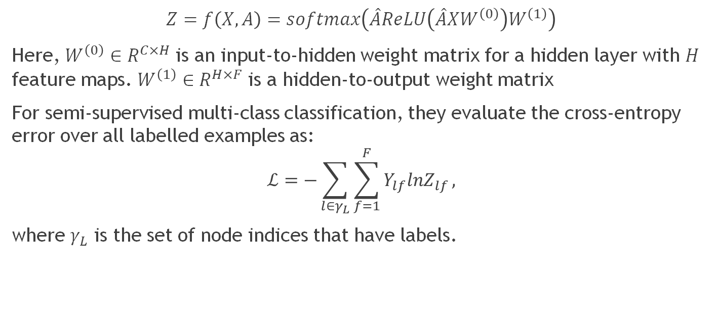
Semi-Supervised Node Classification
$$Z=f\left(X,A\right)=softmax\left(\hat{A}ReLU\left(\hat{A}XW^{\left(0\right)}\right)W^{\left(1\right)}\right)$$
Here, $W^{\left(0\right)}∈R^{C×H}$ is an input-to-hidden weight matrix for a hidden layer with $H$ feature maps. $W^{\left(1\right)}∈R^{H×F}$ is a hidden-to-output weight matrix
For semi-supervised multi-class classification, they evaluate the cross-entropy error over all labelled examples as:
$$ℒ=−\sum_{l∈γ_{L}}{\sum_{f=1}^{F}{Y_{lf}lnZ_{lf}}},$$ where $γ_{L}$ is the set of node indices that have labels.

Slide 14
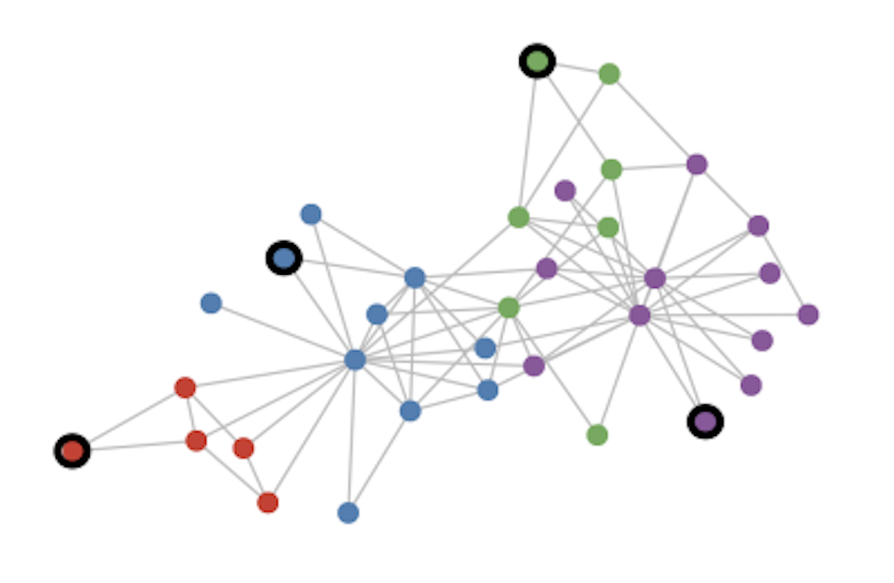
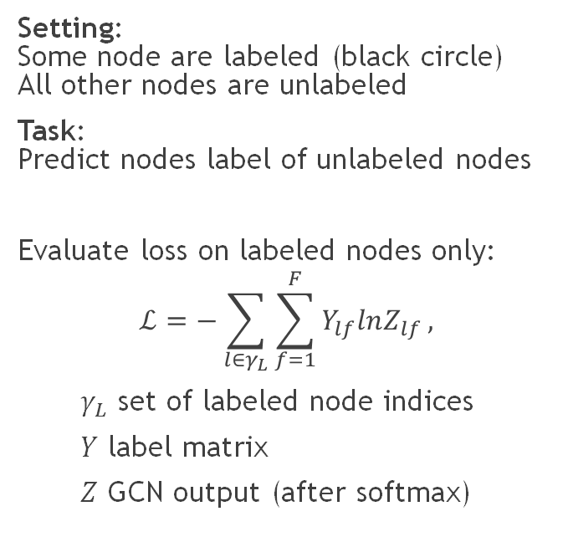
Semi-Supervised Node Classification for graphs
Setting: Some node are labeled (black circle) All other nodes are unlabeled
Task: Predict nodes label of unlabeled nodes
Evaluate loss on labeled nodes only:
$$ℒ=−\sum_{l∈γ_{L}}{\sum_{f=1}^{F}{Y_{lf}lnZ_{lf}}},$$
$γ_{L}$ set of labeled node indices
$Y$ label matrix
$Z$ GCN output (after softmax)

Slide 15
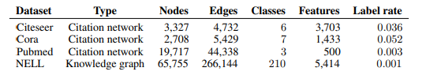
Experimental Set Up
We have used Cora and Pubmed datasets.

Slide 16
Results
Test Accuracy | CORA | PUBMED
Our Model | 80.30% | 78.70%
Paper Model | 81.50% | 79.00%
Pubmed t-SNE visualization
Cora t-SNE visualization

Slide 17
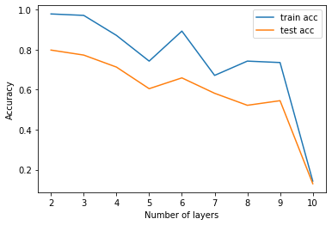
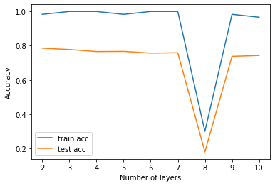
Results
Model depth experiment

Slide 18
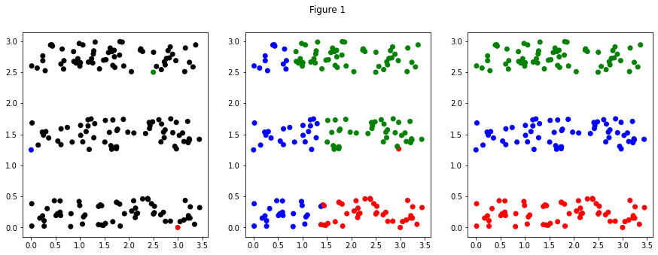
Results
Label Propagation

Slide 19
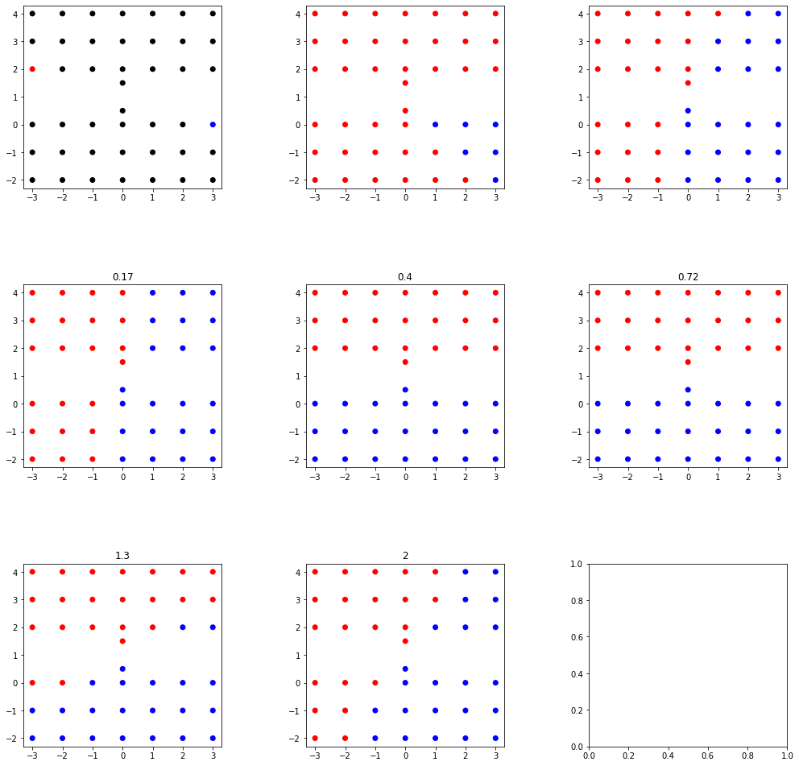
Label Propagation

Slide 20
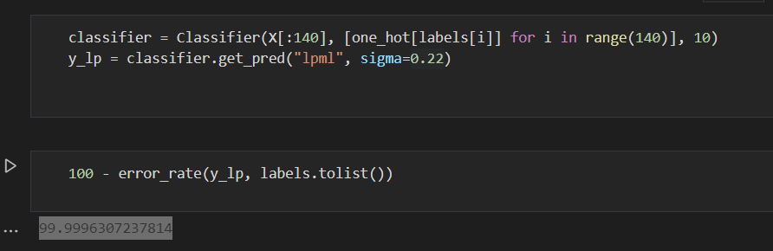

Slide 21
Work Distribution
Aman Atman and Kirthi Vignan Reddy
Writing the code for the label propagation algorithm and GCN from scratch.
Implementation of layer-wise linear model based on graph convolution developed.
Yash Motwani and Rishav Goenka
Implementation of spectral graph convolutions.
Experiments on model depth i.e., Influence of number of layers on accuracy of proposed model.

Slide 22
Thank You

